Slide 1

Project on
CV(Data Extraction )
Using PYTHON

Slide 2
Our Team
Kajal Rituraj & Lopamudra sahoo

Slide 3
Index
1
Introduction And Abstract
1
2
Problem with existing system & need for it
3
Need for new system
4
Advantages
3
6
Code & screenshot
4

Slide 4

Introduction
While searching for jobs the most important thing to represent an applicant is Curriculum Vitae (CV) or Resume. In this era of technology, job searching has become more smart and easier at the same time. However, there are more than enough applicants for a single job and it is really tough for an employer to select candidates only based on their CV/Resume.
Every organization has to deal with folders together with resumes. Going through these 4 resumes can be a tiring process added to the fact that it is very time consuming. It would help a ton if there were to exist a model which processes the resumes and not only gives out how many and lows Go to Settings to activate Windows which of them meet the requirements, but also gives a summarized version of the resumes. These concise resumes can come of great use for a hiring company in their selection procedures.

Slide 5

Abstarct
This project proposes a model of extracting important information from the semi-structured text format in a curriculum vitae or resume and ranking it according to the preference of the associated company and requirements. In order to achieve the desired goal, the entire process has been divided into segments. The first segment consists of segmenting the entire CV/ Resume based on the topic of each part, the second segment consists of extracting data in structured form from the unstructured data extraction process is done by segmenting the entire CV / Resume by converting it to text. After the conversion to structured data, techniques are used to classify the input into different categories based on Email , phone no. , linkedin profile and skills set etc.

Slide 6

Problem Definition
Large companies and recruitment agencies receive, process and manage hundreds of resumes from job applicants. Besides, many people publish their resumes on the web. Dealing with loads of resumes at once can be time consuming since all they need is a bunch of valuable resumes that represent candidates specialized in fields the company/agency is looking for. The resumes that one receives in their original format (pdf, docx etc.) are unstructured. The unstructured format of these resumes, with random templates and fonts make it difficult for processing. These resumes.

Slide 7

Need for new System
The resumes that one receives in their original format (pdf, docx etc.) are unstructured. The unstructured format of these resumes, with random templates and fonts make it difficult for processing. These resumes can be automatically retrieved and processed by a resume information extraction system. Extracted information such as name, phone / mobile nos., e-mails id., qualification, experience, skill sets etc. can be stored as structured information in a database. Considered sample resume or CV

Slide 8

CV/Resume Analyzing Process
In the past, CVs/Resumes submitted by job seekers used to be manually analyzed and judged by the
employers. This method is still followed in recent times. However, as the big companies often need to deal with hundreds of CVs/Resumes each and every day, it has become very problematic and time consuming to handle such a big number of CVs/Resumes one by one. As a result, many companies started to provide specific formats or forms where the job seekers need to fill up with required information and then the CV/Resume will be analyzed by machine with simple pattern recognition and keywords searching. While this method reduced the workload for the employers, it increased the amount of work for the applicants significantly as they need to maintain different formats for each job they apply for. Additionally, it also tends to reduce the creativity and the flexibility of writing the skills along with the qualifications in a CV/Resume.

Slide 9

Advantages
Satisfaction Level
Time Efficiency
Easy to select candidates
Feasible ways to evaluate a CV/Resume
Accuracy level

Slide 10
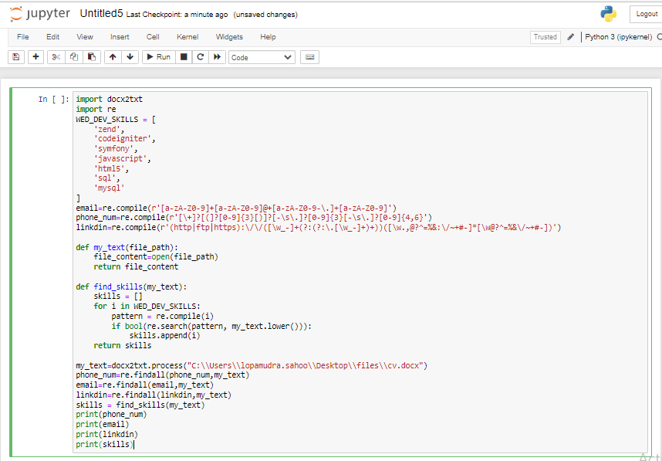

Segment 1: (Phone no.,email ID,Linkedin profile)
Code:
Output:

Slide 11
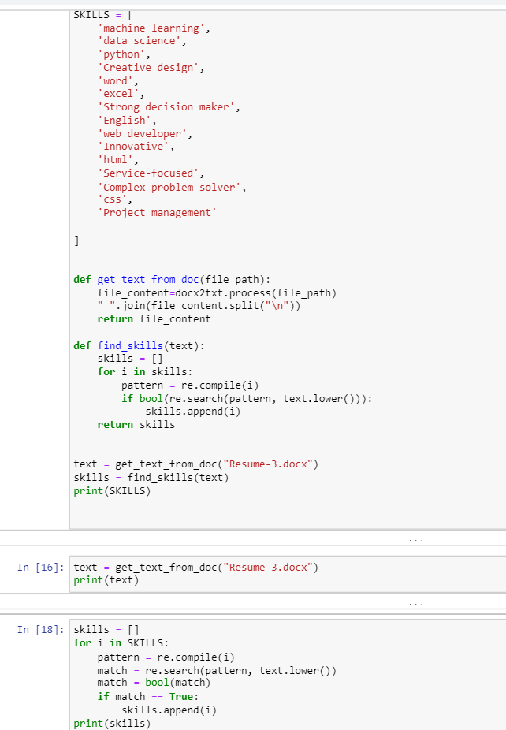
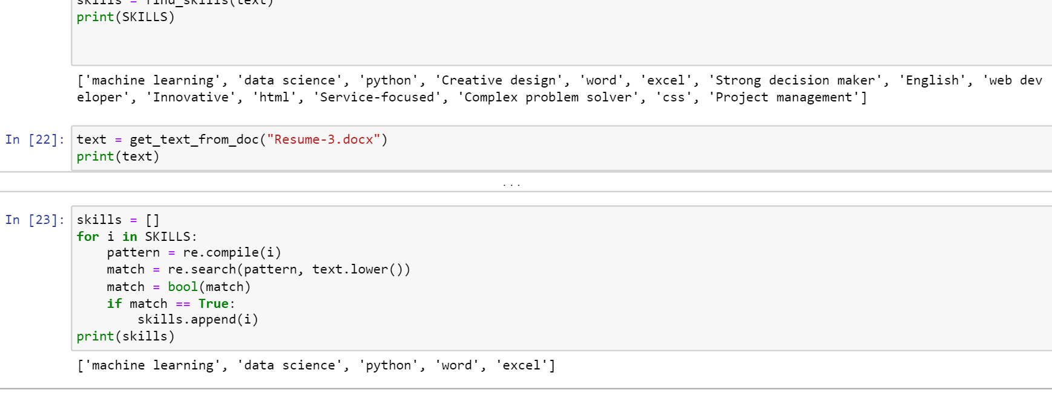
Segment 2: (Technical skills)
Field dependent Technical Skills Programming Languages: Java, C, C++, C# Operating Systems: Windows, Linux Database System: MySQL Web: HTML5, CSS3 Segment 5 (Awards & achievements) .
Code:
Output:

Slide 12

Thank You

